Slide 1

Water Safety and Drowning Prevention
Created by: Kerry Brown – Safeguarding Coordinator Thames Valley ICB

Slide 2

OVERVIEW
In July 2023, the National Child Mortality Database (NCMD) published its thematic report Deaths of children and young people due to traumatic incidents, which highlighted evidence of an increase in the number of child drowning deaths in England, from 20 in 2019-20 to 37 in 2021-22
Child Drowning Update September 2024: England | Royal Life Saving Society UK ( RLSS UK )
Their latest briefing Child drowning deaths – 1 April 2019 to 31 March 2025 builds on the findings of the report and reinforces the recommendations made.
Child drowning deaths 2019-2025
NHS Thames Valley ICB are championing resources to reach all, with a focus on parents and carers of children under 5, individuals aged between 13-17 years old and those with additional needs.

Slide 3
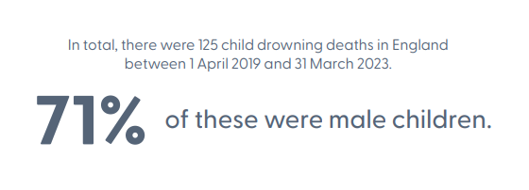
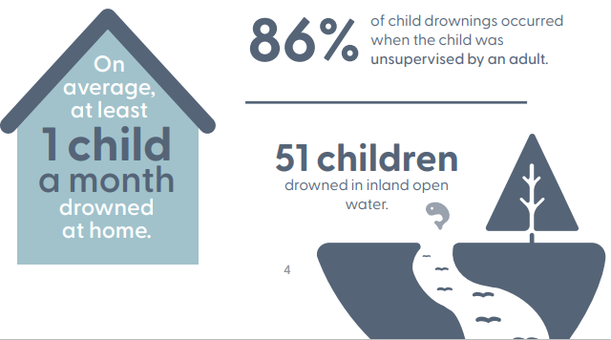
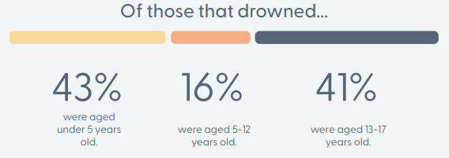
HEADLINE FACTS
Children of black ethnicity had more than three times the risk of drowning compared with children of white ethnicity
Source: Child Drowning Update September 2024: England | Royal Life Saving Society UK ( RLSS UK )
Child drowning deaths 2019-2025

Slide 4

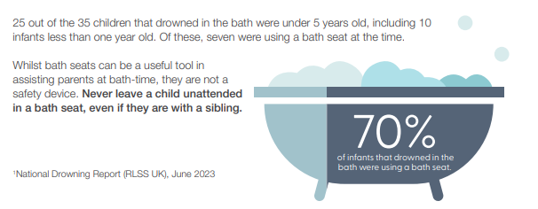
SUPERVISION
A lack of supervision remains a contributory factor across all accidental child drownings, and where recorded, 86% occurred when the child was unsupervised by an adult.

Slide 5

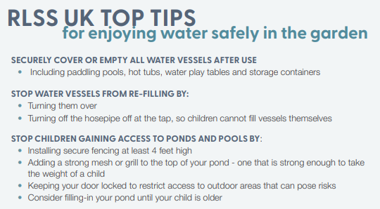
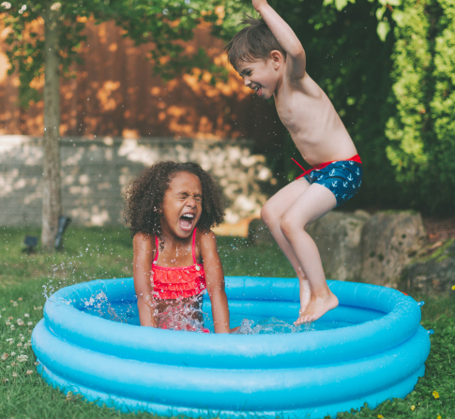
SUPERVISION

Slide 6
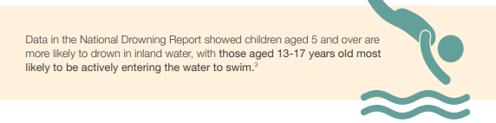
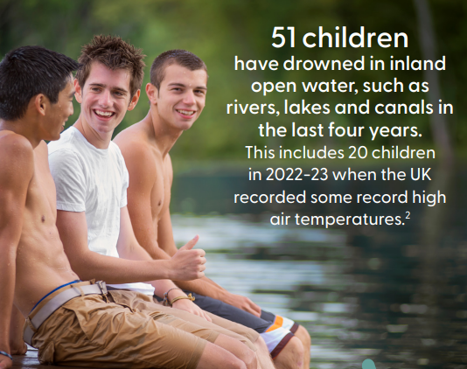
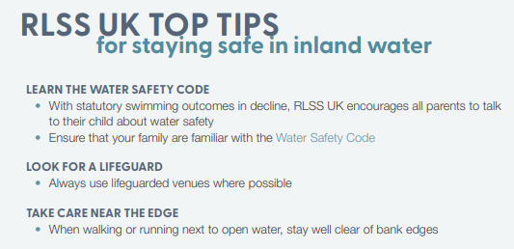
DROWNINGS IN INLAND OPEN WATER

Slide 7


SEND WATER SAFETY RESOURCES
Children with special educational needs and disabilities (SEND) face a significantly higher risk of drowning compared to their neurotypical peers. According to the National Autism Association, children with autism are 160 times more likely to die from accidental drowning. To promote accessibility and inclusion, adaptable lesson plans and resources that align with the ‘Health and Wellbeing’ curriculum requirements and follow the SEND Framework from the PSHE Association are available for free via the Royal Life Saving Society UK. These materials are designed to maximise engagement in water safety education.
VIEW AND ACCESS SEND RESOURCES

Slide 8

MULTIPLE LANGUAGE RESOURCES
Language should not be a barrier to getting safety messages out to the diverse communities across the UK and Ireland. There are resources created by the Royal National Lifeboat Institution and the Royal Life Saving Society to try and reach as many people as possible in their mission to prevent drowning and save lives.
Multi-lingual Posters and Safety Resources
The Water Safety Code in multiple languages | Royal Life Saving Society UK ( RLSS UK )

Slide 9
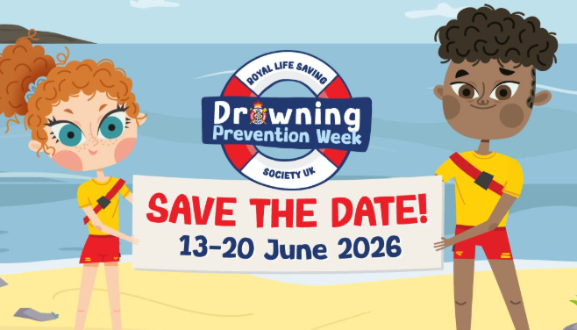
DROWNING PREVENTION WEEK
Drowning Prevention Week is deliberately timed ahead of the school summer holidays when children spend more time outdoors and when vital water safety skills can help keep children safe.
Drowning Prevention Week (DPW) is one of the largest summer water safety campaigns across the UK and Ireland.
Save the date for 2026:
13- 20 June.
Royal Life Saving Society UK's Drowning Prevention Week

Slide 10
CAMPAIGNING COLLABORATIVELY
OBJECTIVE:
Increase water safety within the identified vulnerable age groups:
0-5 years
13-17 years
Those with additional needs
STRATEGY:
Sharing and creating visuals that align with the messaging from RNLI, sharing widely with partners for maximum reach and impact, including multilingual resources and resources aimed for those with SEND
MESSAGING:
Float to live
Test the water
Supervision

Slide 11
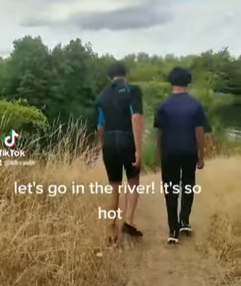
SOCIAL MEDIA ASSETS
Sharing a video made by local young people following a tragedy within their local area will help to resonate with younger people – reaching them on platforms they regularly engage with allows the opportunity to spread the message.
Message:
Test the water - cold water kills. All waters in the UK are cold enough to kill you – even during hot summers. Knowing how to float can save your life…
https://youtu.be/jdcxThIHUmc
CLICK THROUGH TO VIDEO

Slide 12
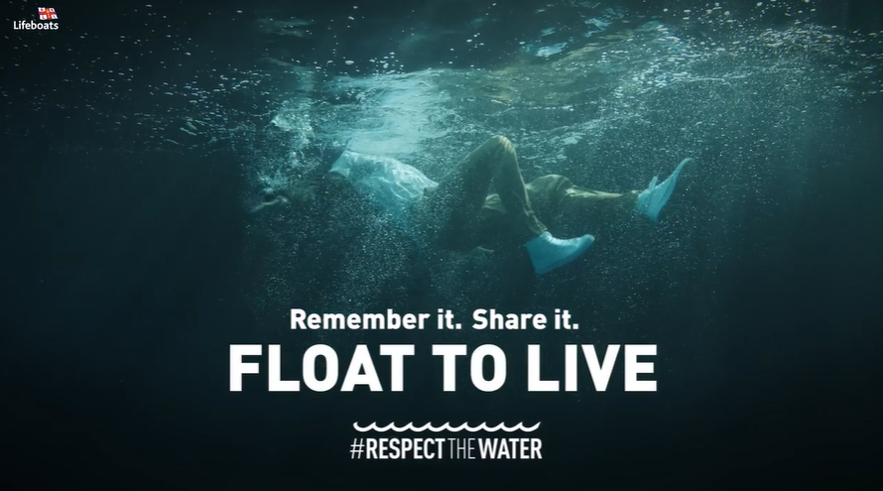
SOCIAL MEDIA ASSETS
ACCESS VIDEO HERE
Message:
Knowing how to float can save your life! Over 60% of drownings happen when people accidently fall into water. Read more here about how to stay safe aroundBeing Safe Around Water :: Frimley HealthierTogether
Float to Live Toolkit: resources for download

Slide 13
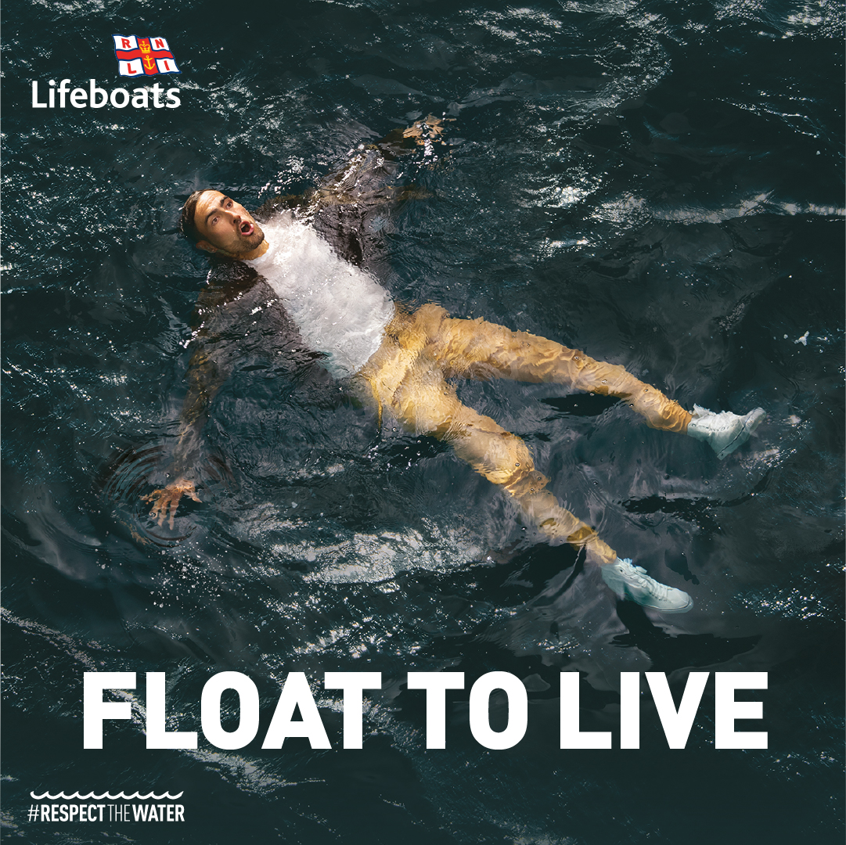
SOCIAL MEDIA ASSETS
Message:
Knowing how to float can save your life! Over 60% of drownings happen when people accidently fall into water.
Read more here about how to stay safe around waterBeing Safe Around Water :: Frimley HealthierTogether
Float to Live Toolkit: resources for download

Slide 14
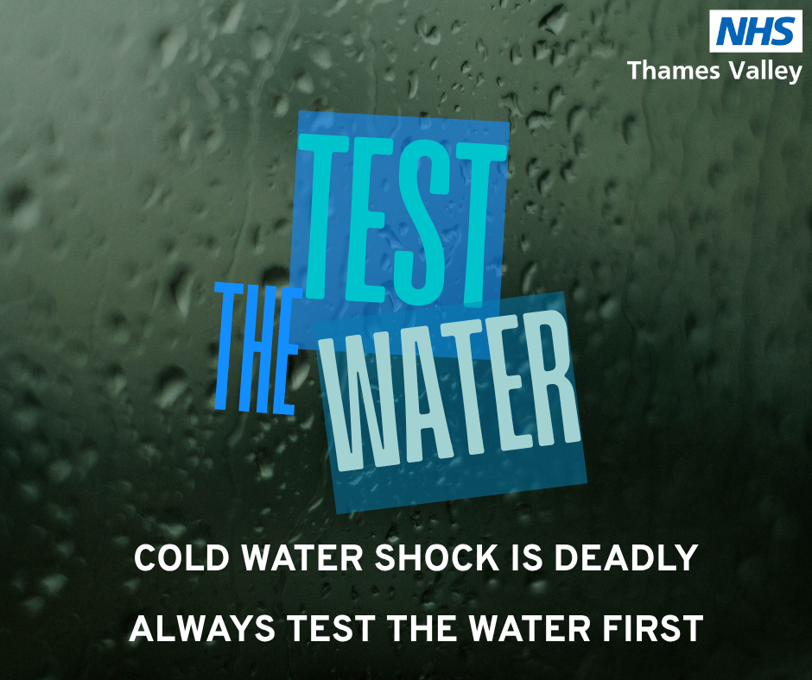
SOCIAL MEDIA ASSETS
Message:
Test the water - cold water kills. All waters in the UK are cold enough to kill you – even during hot summers
https://frimley-healthiertogether.nhs.uk/parentscarers/keeping-your-child-safe/being-safe-around-water

Slide 15
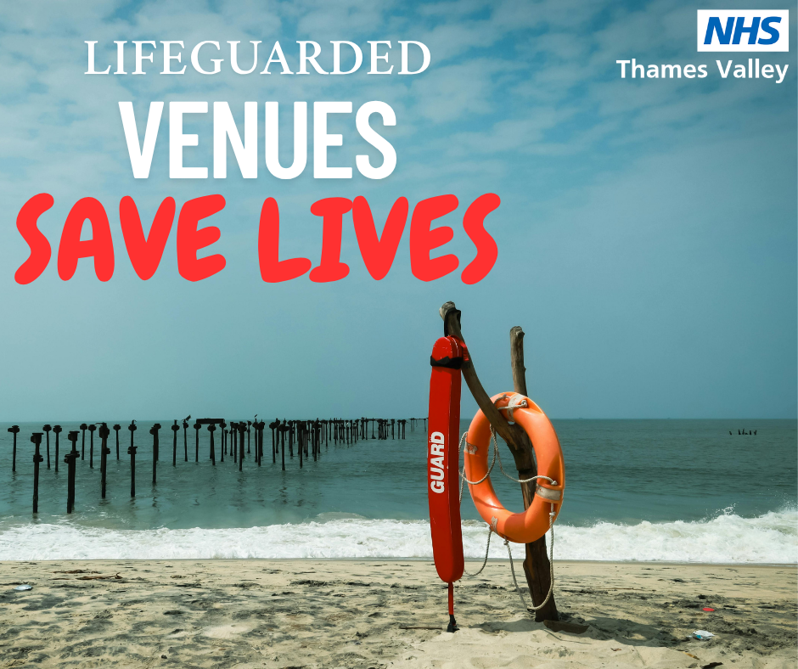
SOCIAL MEDIA ASSETS
Message:
In 2023 RNLI lifeguards aided 19,979 people on the beach. They can see the dangers before they develop and respond instantly if anyone gets into difficulty.
Advice to enjoy being in, on and around water safely | Royal Life Saving Society UK ( RLSS UK )

Slide 16

SOCIAL MEDIA ASSETS
Message:
Young children can drown in less than two inches of water in only 20 seconds.
Always supervise babies or young children when they are in or around any water.
Splash Safety in the Bath
Accidents and injuries - Keeping your child safe in the home :: Frimley HealthierTogether

Slide 17
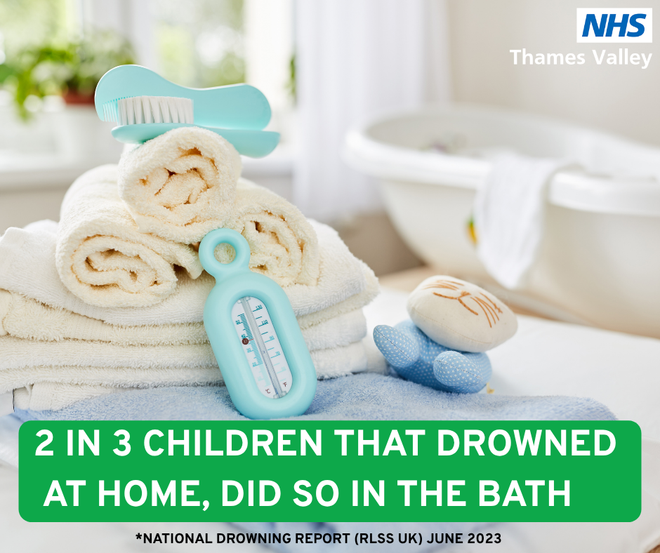
SOCIAL MEDIA ASSETS
Message:
Young children can drown in less than two inches of water in only 20 seconds.
Always supervise babies or young children when they are in or around any water.
(Splash Safety in the Bath)
Accidents and injuries - Keeping your child safe in the home :: Frimley HealthierTogether

Slide 18
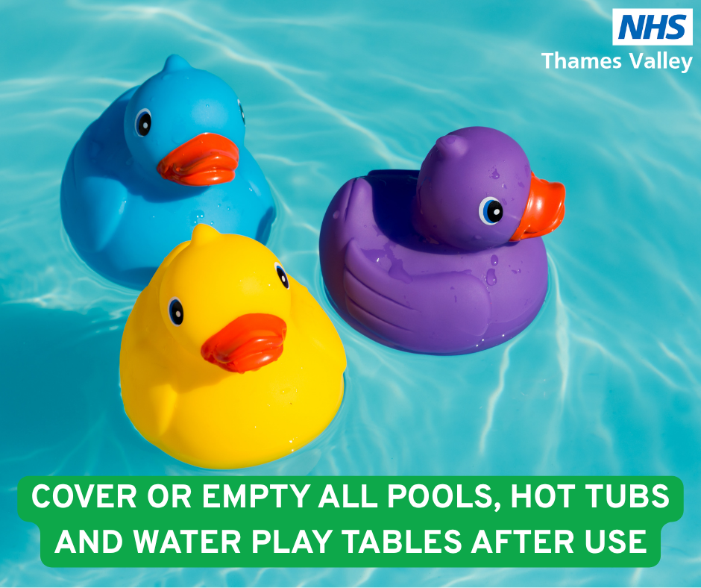
SOCIAL MEDIA ASSETS
Accidents and injuries - Keeping your child safe in the home :: Frimley HealthierTogether
Message:
Young children can drown in less than two inches of water in only 20 seconds. Stay safe at home this Summer with these top tips
Splash Safety at Your Pad - Water Safety at Home

Slide 19
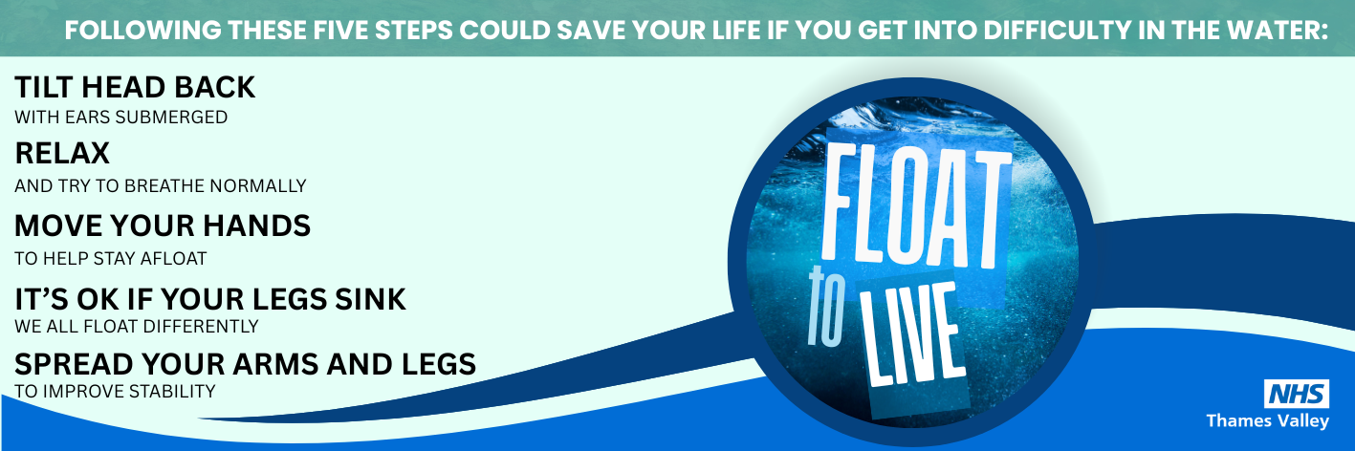
EMAIL SIGNATURE
FLOAT TO LIVE CAMPAIGN
Cold Water Shock – the Facts
Being Safe Around Water :: Frimley HealthierTogether

Slide 20
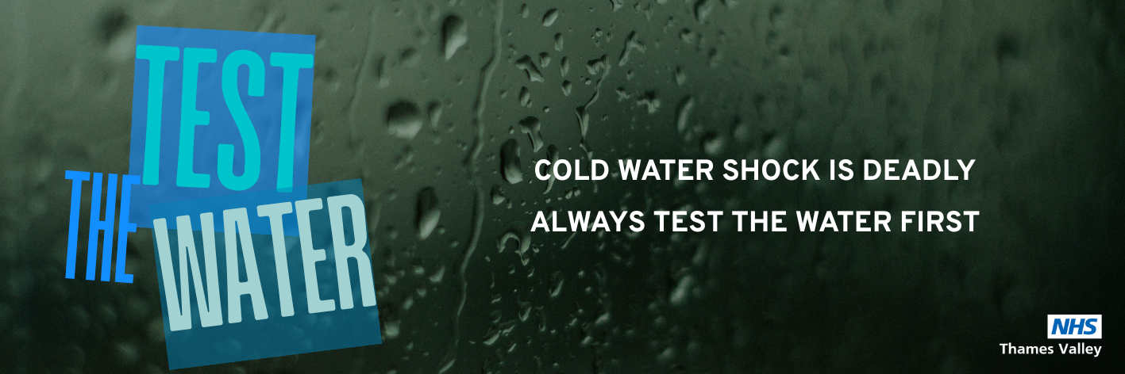
EMAIL SIGNATURE
TEST THE WATER
Cold Water Shock – the Facts
Being Safe Around Water :: Frimley HealthierTogether

Slide 21
Please feel free to use the social media assets and email signatures within this campaign

