Slide 1
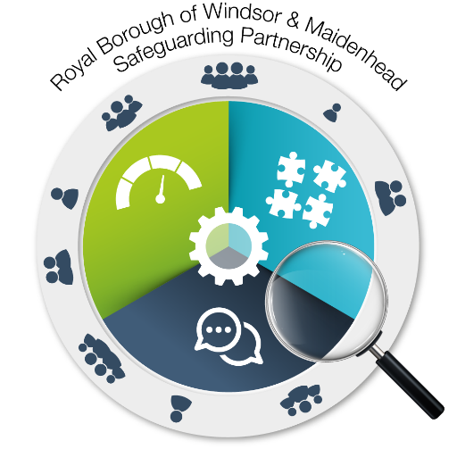
Multi-Agency Risk Management Framework
A Framework for Multi Agency Working in Situations Involving Risk to Service Users in Bracknell Forest and the Royal Borough of Windsor & Maidenhead
Notes:
Welcome. We hope the following presentation will introduce you to our multi agency risk management framework and risk recording tool. We’re not able to provide face to face training at the moment so hope this helps you understand how the framework and tool can help you manage risk approporiately.

Slide 2
Just to clarify……….
The Multi Agency Risk Management Framework is the overall policy / process
The Risk Recording Tool is what you actually use to record and manage the risk
The tool is available as a word document and can be attached to case records etc
See the relevant page on your safeguarding partnership website – Bracknell available here and RBWM here
Notes:
The risk management framework provides the overall policy while the tool is what you actually use to record but also guide you through the process
The recording tool is available as a word document and can be adapted electronically depending on organisation and system capabilities
The multi agency risk management framework and recording tool were developed for use on cases in Bracknell Forest and the Royal Borough of Windsor & Maidenhead. You can find out more information from our safeguarding partnership websites using the links above.
Please note Slough has a similar but slightly different framework, which is available on the Slough partnership website.

Slide 3
Aim
To raise awareness of the multi-agency risk management framework
To outline the process for applying the multi-agency risk management framework
To highlight the risk recording tool
Notes:
These are the four aims of this session – we want to enable you to use the risk management framework effectively.

Slide 4
Background to the Risk Management Framework
Learning from Safeguarding Adult Reviews
Clarity for practitioners and partners where people choose not to engage in safeguarding measures for themselves
Recognition of need for an overarching multi-agency risk management framework
Care Act 2014, early intervention / prevention
Notes:
The local safeguarding adults boards identified a need to help practitioners manage risk in certain circumstances, particularly when people chose not to engage with us.

Slide 5
The Multi Agency Risk Management Approach
A proactive approach – aims to identify/respond to risks before crisis point reached.
Aims to enable and involve adults to retain control over their life
Recognises the duty to protect adults from foreseeable harm even when the adult doesn’t want to engage
Supports timely information sharing around risk
Provides holistic, collaborative and co-ordinated assessment & management of risk
Development of shared risk management plans
Notes:
This is the approach partners in Bracknell Forest and the Royal Borough have adopted to manage risk.
It should not be confused with “business as usual” safeguarding (section 42 etc). So safeguarding referrals should continue to be made in the normal way.
The framework complements established safeguarding and risk management processes including existing partner arrangements

Slide 6
Who might benefit from this Risk Management Framework?
Adults with complex or diverse needs that either fall between, or span a number of agencies’ statutory responsibilities or eligibility criteria
People where the section 42 local authority safeguarding enquiry is not appropriate
People where capacity, unwise decision making and disengagement feature; this may include self-neglect, hoarding
Adults who are well known to services due to their frequent involvement
Notes:
The framework and tool should help you to risk assess cases where you feel there is a high level of risk but circumstances may sit outside the statutory adult safeguarding framework. For example, complex cases often dealing with long term entrenched behaviours to which responses require a commitment to longer term solutions based focus on building trust and a rapport with the adult.
Meet criteria for a safeguarding enquiry but chooses not to engage.
You could also use it for people who may be a risk to others, such as creating a fire hazard, and it can also be used in cases of self neglect and hoarding.

Slide 7
Principles
Multi-agency and overarching
Complements established safeguarding and risk management processes including existing partner arrangements
Adheres to the six safeguarding principles as well as the wellbeing principle
Person-centred
Positive approach to risk - balancing choice, independence, well-being & safety
MSP link - https://www.scie.org.uk/care-act-2014/safeguarding-adults/safeguarding-adults-boards-checklist-and-resources/making-safeguarding-personal.asp
Notes:
The multi agency framework and tool don’t replace your single agency risk management arrangements and instead seeks to build on and complement by providing a multi-agency approach.
You should also refer to relevant statutory frameworks and operational policies which you are required to follow.
Be aware that your risk assessment may highlight circumstances of risks that would be more appropriately dealt with under another process e.g Marac
A balance therefore has to be achieved between the desire of people to do everyday activities with the duty of care owed by services and employers to their staff and to users of services, and the legal duties of statutory and community services and independent providers. As well as considering the dangers associated with risk, the potential benefits of risk-taking have to be identified (‘nothing ventured, nothing gained’). This should involve everyone affected – adults who use services, their families and practitioners.
The approach to risk is rights based and people using services are kept well informed in an accessible way.
The wishes of people using services are at the heart of decisions which should be balanced with demonstrable reasoning. These decisions should be regularly reviewed.
Dave to include a link to the one pager on MSP

Slide 8
Process - Factors to consider when using this framework
An agency has concerns regarding an adult at who may be at risk
Agency works with adult regarding perceived risk
- have all existing processes been considered
- Is there an existing multi agency forum
Mental capacity must be ascertained & reviewed; an adult who lacks capacity should receive a response via Safeguarding procedures
Consider legal advice if necessary
Decide whether to proceed to multi agency meeting
Notes:
It’s important to emphasise that any agency can use the framework and hold a risk management meeting. You don’t need to ask the local authority to initiate it.

Slide 9
Process – Multi Agency Meeting
Any agency can initiate & take the lead role & responsibility for convening & chairing initial meeting.
The lead agency must invite all agencies who have, or could have had, involvement with the individual
Adult should, as far as possible, be included
The purpose is to consider the situation & clarify if any further action can be taken, making the necessary recommendations
A risk assessment should be discussed at the first meeting and updated in light of information from other agencies.
Agree action plan, with timescales and named leads.
Identify who is best placed to engage with the person to provide advice or information of decisions made
Notes:
Information sharing by all agencies is implicit for this guidance; consent should be sought to share information as per local information sharing protocol, unless to do so places the adult or those around him/her at further risk of harm.
It should be documented in the tool whether consent has been given and the reasoning for sharing information where consent has not been given.
Appropriate Information is securely shared when it is relevant and proportionate to the risk identified, to those who have a need to know.

Slide 10
Process – On going meetings and support
Review progress and agree a revised action plan
Update the risk assessment and actions
If insufficient progress has been made, consider an alternative approach; escalate concerns if risks are considered high & progress has been insufficient
Process continues until the identified risks are either resolved or managed to an acceptable level; regular meetings can be stopped
Any ongoing support must be clearly identified and agreed by relevant agencies.
Learning and good practice should be shared with wider networks and Safeguarding Adults Boards

Slide 11
Adults who may lack mental capacity
An adult may need support in their decision making due to their mental capacity
If there is a possibility an adult lacks capacity in relation to being at risk, the mental capacity act must be considered as an appropriate approach
If this is the case an appropriate mental capacity assessment may be required and may result in a best interest decision being made

Slide 12
Making Decisions where risk is involved
Thinking about risk often involves an engagement with complex dilemmas and an acceptance that there may be no ideal solution
(Faulkner, 2012)

Slide 13
Multi Agency Risk Management Framework - Summary
Its enabling people to find their own solutions, make their own sustainable plans, using support and the capacity with the people who are significant to them
It enables creative problem solving – together; it’s about having difficult conversations
That applies just as much to how we all work together, as it does to how we work with local residents

Slide 14
References & Further Information
Multi agency risk framework
Local government association making safeguarding personal; working with risk https://www.local.gov.uk/our-support/our-improvement-offer/care-and-health-improvement/making-safeguarding-personal/working-risk
Local government association making safeguarding personal resources https://www.local.gov.uk/our-support/our-improvement-offer/care-and-health-improvement/making-safeguarding-personal/resources
Audio visual resources https://www.local.gov.uk/topics/social-care-health-and-integration/adult-social-care/making-safeguarding-personal-audio-visual-resources
Service user involvement audio visual resources https://www.local.gov.uk/sites/default/files/documents/Real%20safeguarding%20stories%20info.pdf
Research in practice – risks, rights, values and ethics; frontline briefing 2018, Lydia Guthrie
Notes:
Need to check these links

