Slide 1

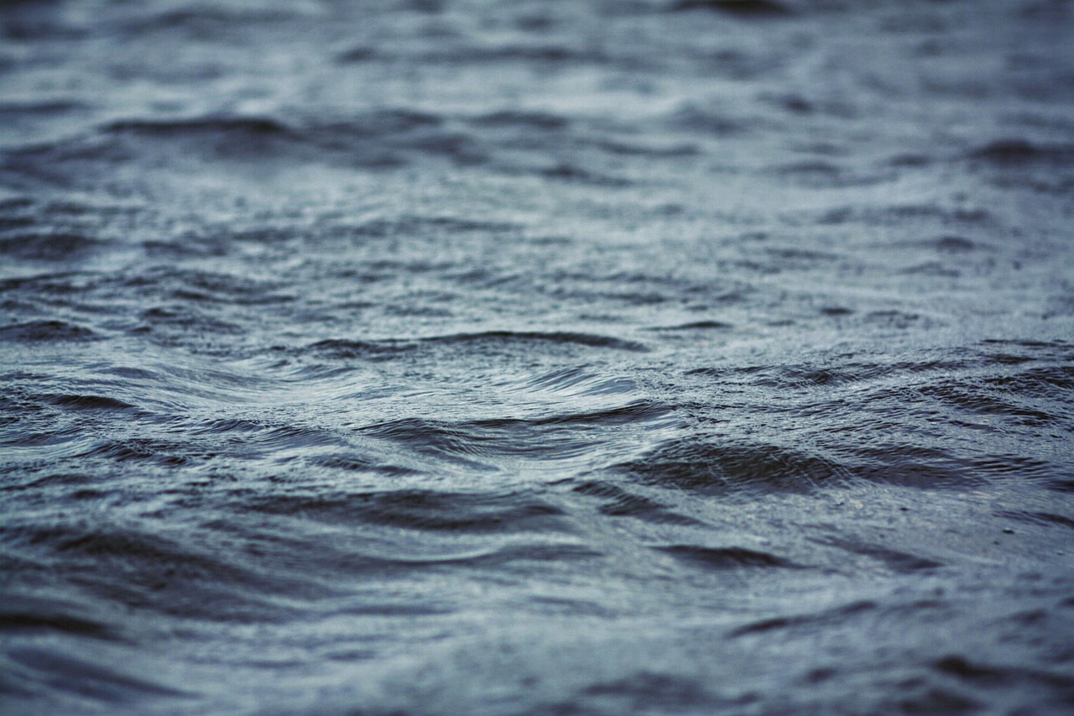

Water Safety and Drowning Prevention
Created by: The Safeguarding Team – Frimley ICB

Slide 2

OVERVIEW
In July 2023, the National Child Mortality Database (NCMD) published its thematic report Deaths of children and young people due to traumatic incidents, which highlighted evidence of an increase in the number of child drowning deaths in England, from 20 in 2019-20 to 37 in 2021-22
Child Drowning Update September 2024: England | Royal Life Saving Society UK ( RLSS UK )
NHS Frimley are championing resources to reach all, with a focus on parents and carers of children under 5, and individuals aged between 13-17 years old.

Slide 3
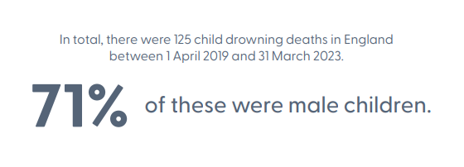
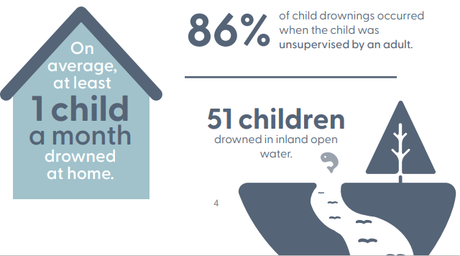
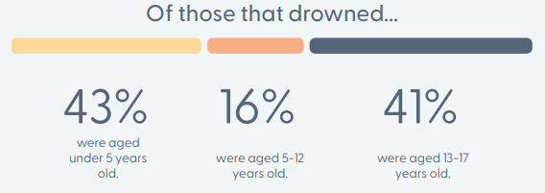
HEADLINE FACTS
Source: Child Drowning Update September 2024: England | Royal Life Saving Society UK ( RLSS UK )

Slide 4

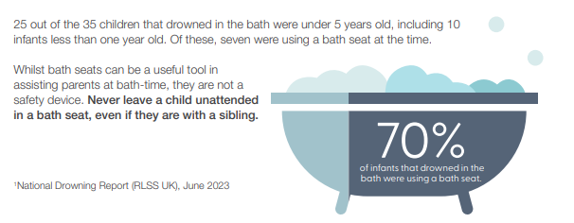
SUPERVISION
A lack of supervision remains a contributory factor across all accidental child drownings, and where recorded, 86% occurred when the child was unsupervised by an adult.

Slide 5

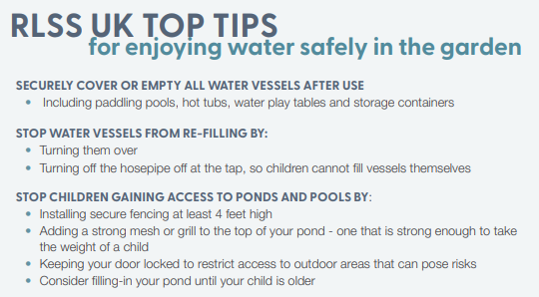
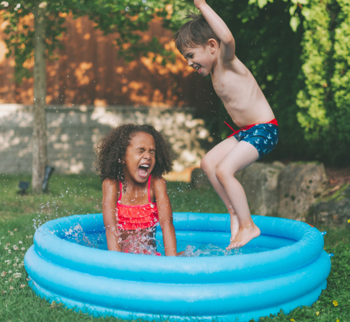
SUPERVISION

Slide 6
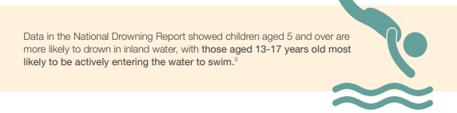
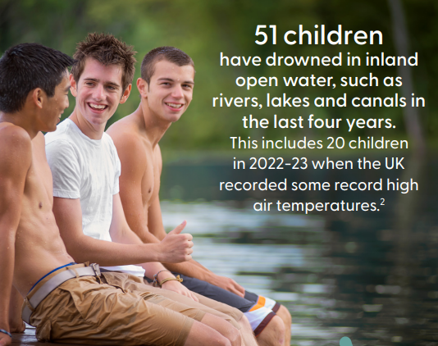
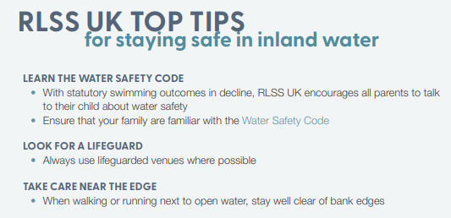
DROWNINGS IN INLAND OPEN WATER

Slide 7
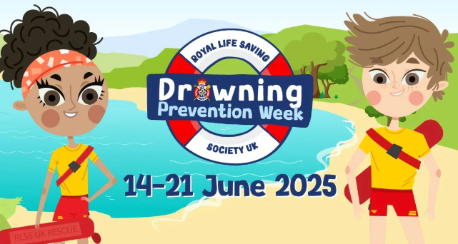
DROWNING PREVENTION WEEK
Drowning Prevention Week is deliberately timed ahead of the school summer holidays when children spend more time outdoors and when vital water safety skills can help keep children safe.
Drowning Prevention Week (DPW) is one of the largest summer water safety campaigns across the UK and Ireland.
Save the date for 2025:
14 - 21 June.
Royal Life Saving Society UK's Drowning Prevention Week

Slide 8
CAMPAIGNING COLLABORATIVELY
OBJECTIVE:
Increase water safety within the identified vulnerable age groups:
0-5 years
13-17 years
STRATEGY:
Sharing and creating visuals that align with the messaging from RNLI, sharing widely with partners for maximum reach and impact
MESSAGING:
Float to live
Test the water
Supervision

Slide 9
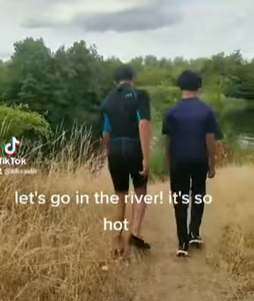
SOCIAL MEDIA ASSETS
Sharing a video made by local young people following a tragedy within their local area will help to resonate with younger people – reaching them on platforms they regularly engage with allows the opportunity to spread the message.
Message:
Test the water - cold water kills. All waters in the UK are cold enough to kill you – even during hot summers. Knowing how to float can save your life…
https://youtu.be/jdcxThIHUmc
CLICK THROUGH TO VIDEO

Slide 10
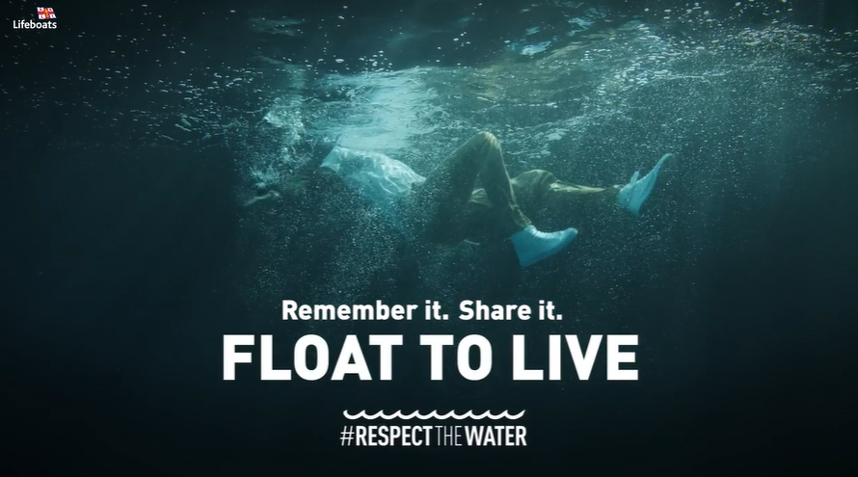
SOCIAL MEDIA ASSETS
Message:
Knowing how to float can save your life! Over 60% of drownings happen when people accidently fall into water. Read more here about how to stay safe around Being Safe Around Water :: Frimley HealthierTogether
VIDEO FLOAT TO LIVE
Float to Live Toolkit: resources for download

Slide 11
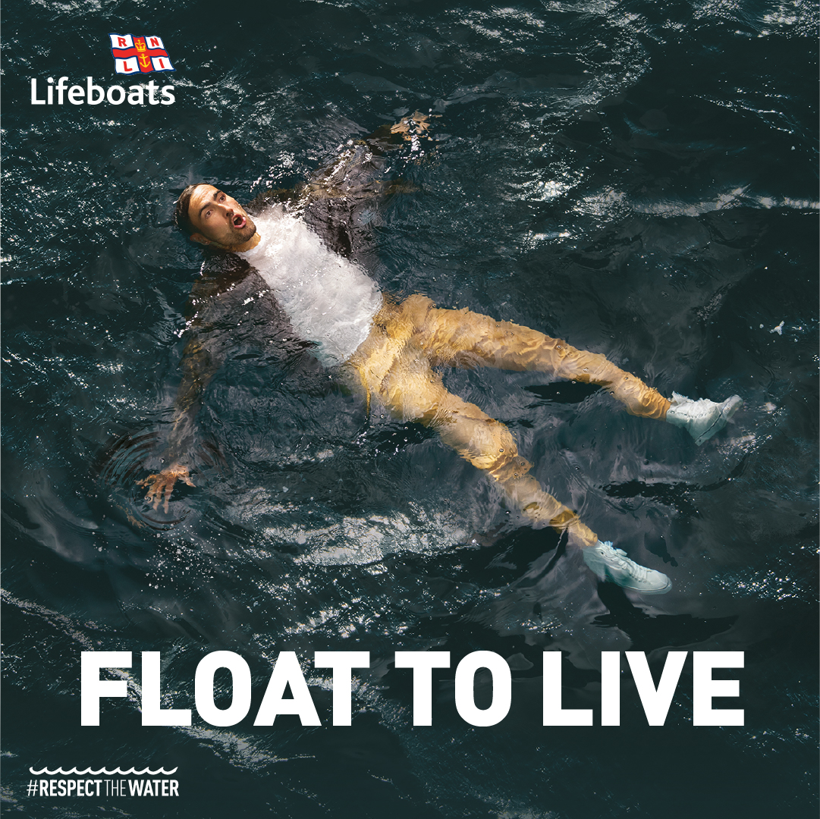
SOCIAL MEDIA ASSETS
Message:
Knowing how to float can save your life! Over 60% of drownings happen when people accidently fall into water.
Read more here about how to stay safe around waterBeing Safe Around Water :: Frimley HealthierTogether
Float to Live Toolkit: resources for download

Slide 12
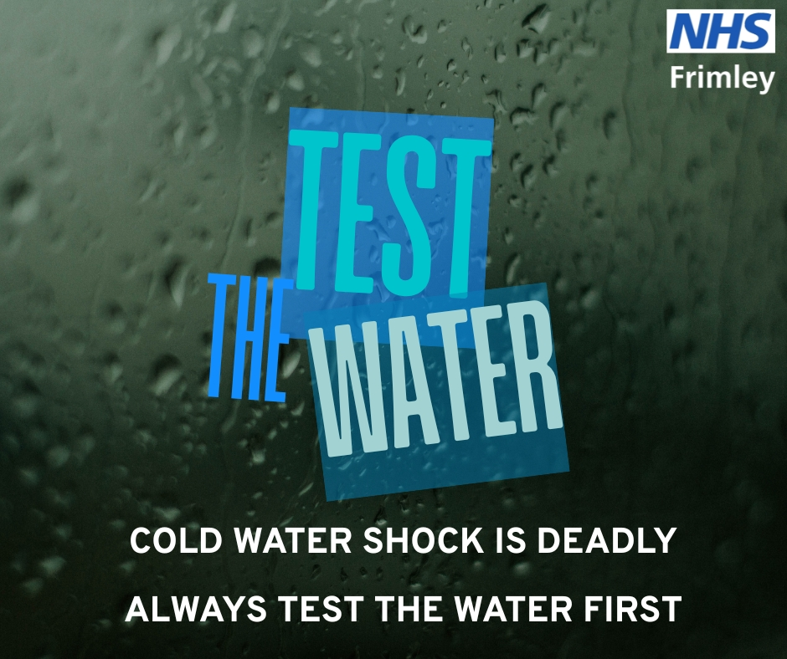
SOCIAL MEDIA ASSET 4
Message:
Test the water - cold water kills. All waters in the UK are cold enough to kill you – even during hot summers
https://frimley-healthiertogether.nhs.uk/parentscarers/keeping-your-child-safe/being-safe-around-water

Slide 13
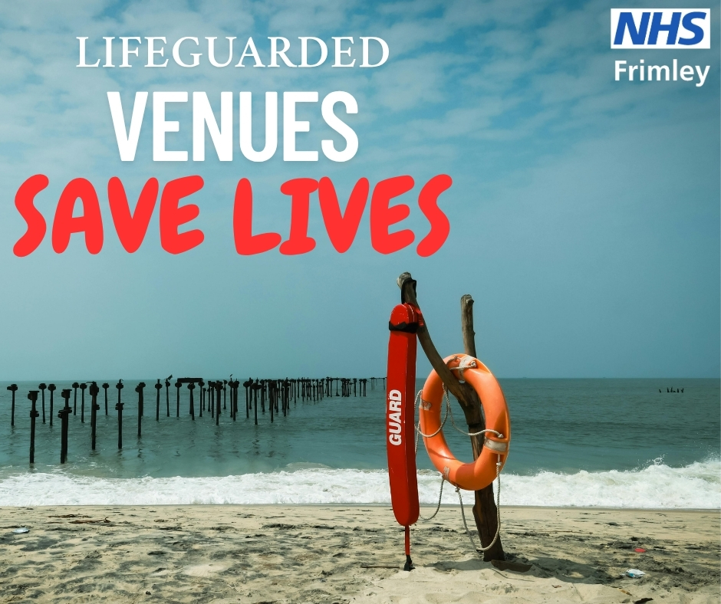
SOCIAL MEDIA ASSET 5
Message:
In 2023 RNLI lifeguards aided 19,979 people on the beach. They can see the dangers before they develop and respond instantly if anyone gets into difficulty.
Advice to enjoy being in, on and around water safely | Royal Life Saving Society UK ( RLSS UK )

Slide 14
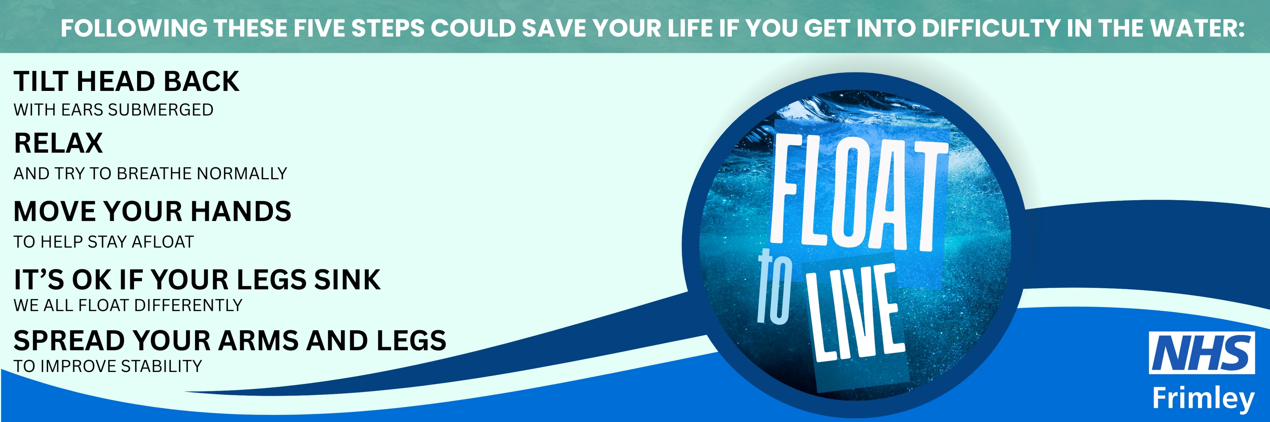
EMAIL SIGNATURE 1
FLOAT TO LIVE CAMPAIGN
Cold Water Shock – the Facts
Being Safe Around Water :: Frimley HealthierTogether

Slide 15
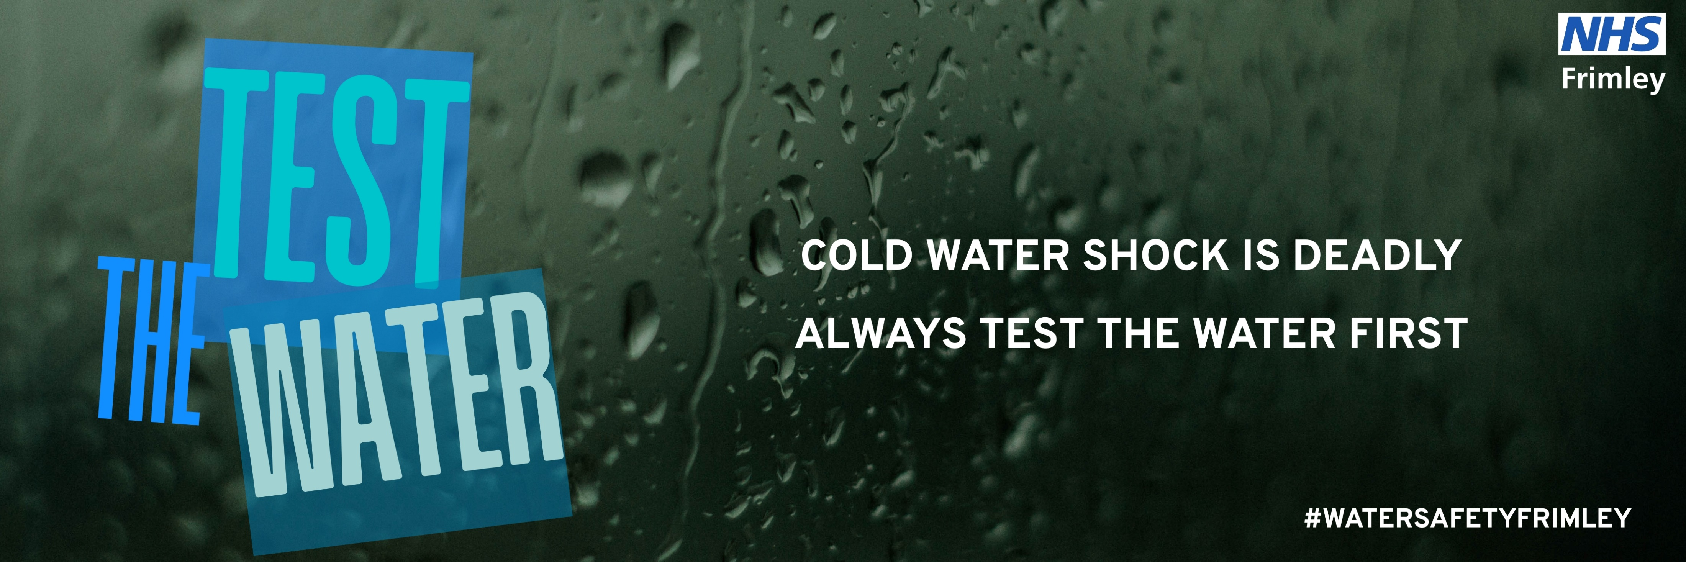
EMAIL SIGNATURE 2
TEST THE WATER
Cold Water Shock – the Facts
Being Safe Around Water :: Frimley HealthierTogether

Slide 16
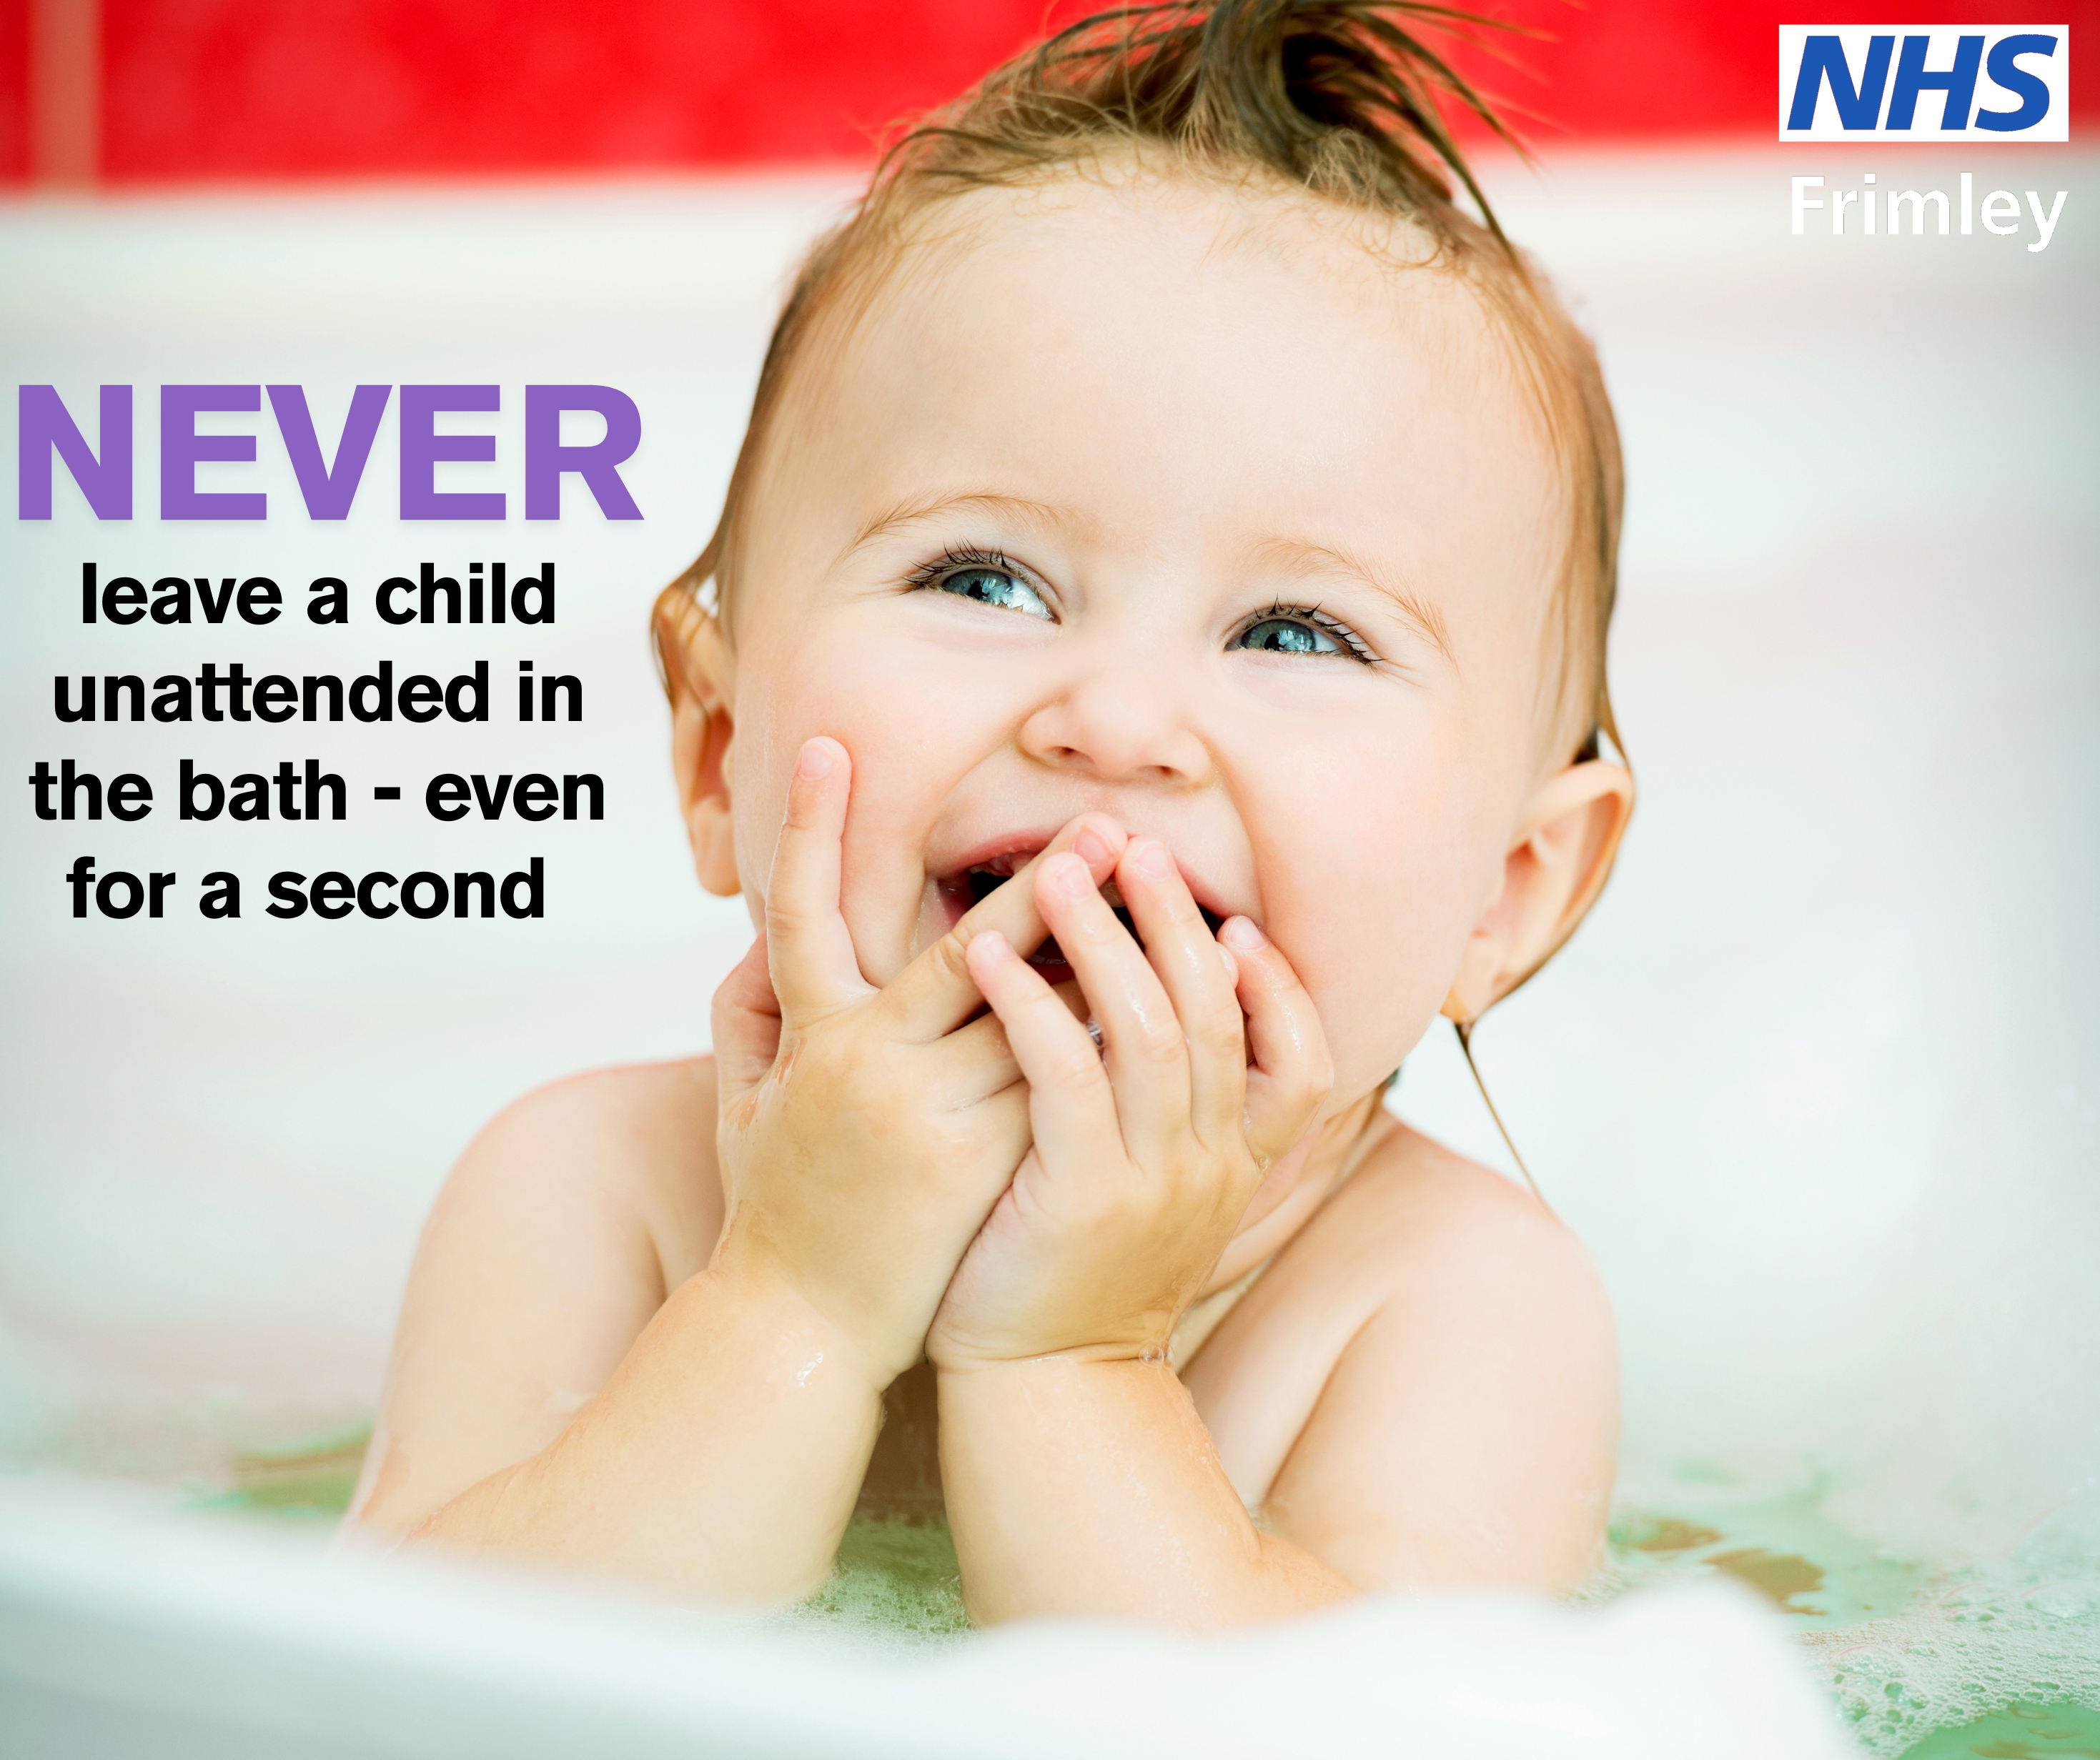
SOCIAL MEDIA ASSET 6
Message:
Young children can drown in less than two inches of water in only 20 seconds.
Always supervise babies or young children when they are in or around any water.
Splash Safety in the Bath
Accidents and injuries - Keeping your child safe in the home :: Frimley HealthierTogether
Source: Child Drowning Update September 2024: England | Royal Life Saving Society UK ( RLSS UK )

Slide 17
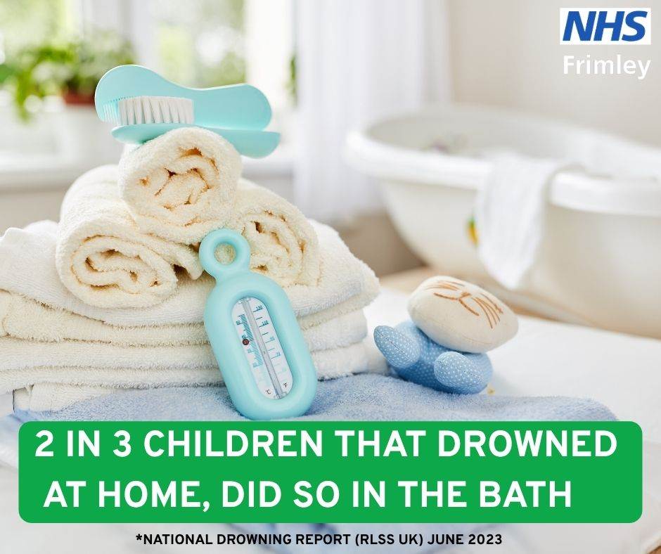
SOCIAL MEDIA ASSET 7
Message:
Young children can drown in less than two inches of water in only 20 seconds.
Always supervise babies or young children when they are in or around any water.
(Splash Safety in the Bath)
Accidents and injuries - Keeping your child safe in the home :: Frimley HealthierTogether

Slide 18
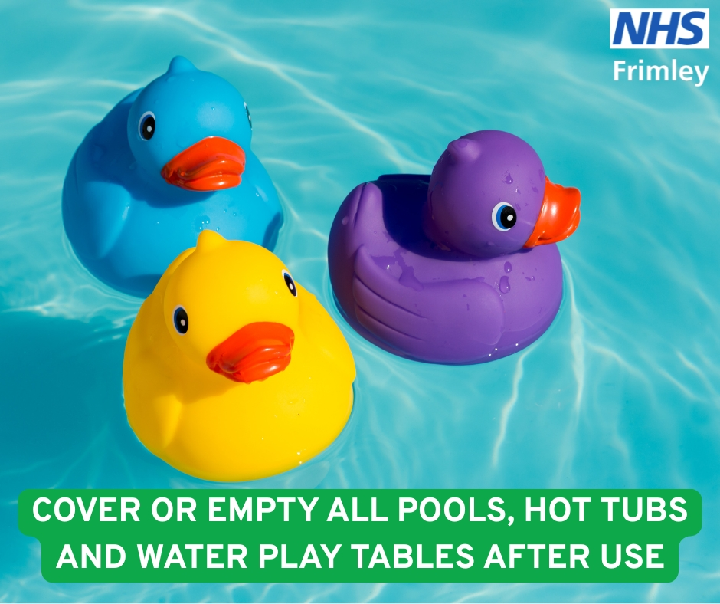
SOCIAL MEDIA ASSET 8
Splash Safety at Your Pad - Water Safety at Home
Message:
Young children can drown in less than two inches of water in only 20 seconds. Stay safe at home this Summer with these top tips
Splash Safety at Your Pad - Water Safety at Home
Accidents and injuries - Keeping your child safe in the home :: Frimley HealthierTogether

